Slide 1
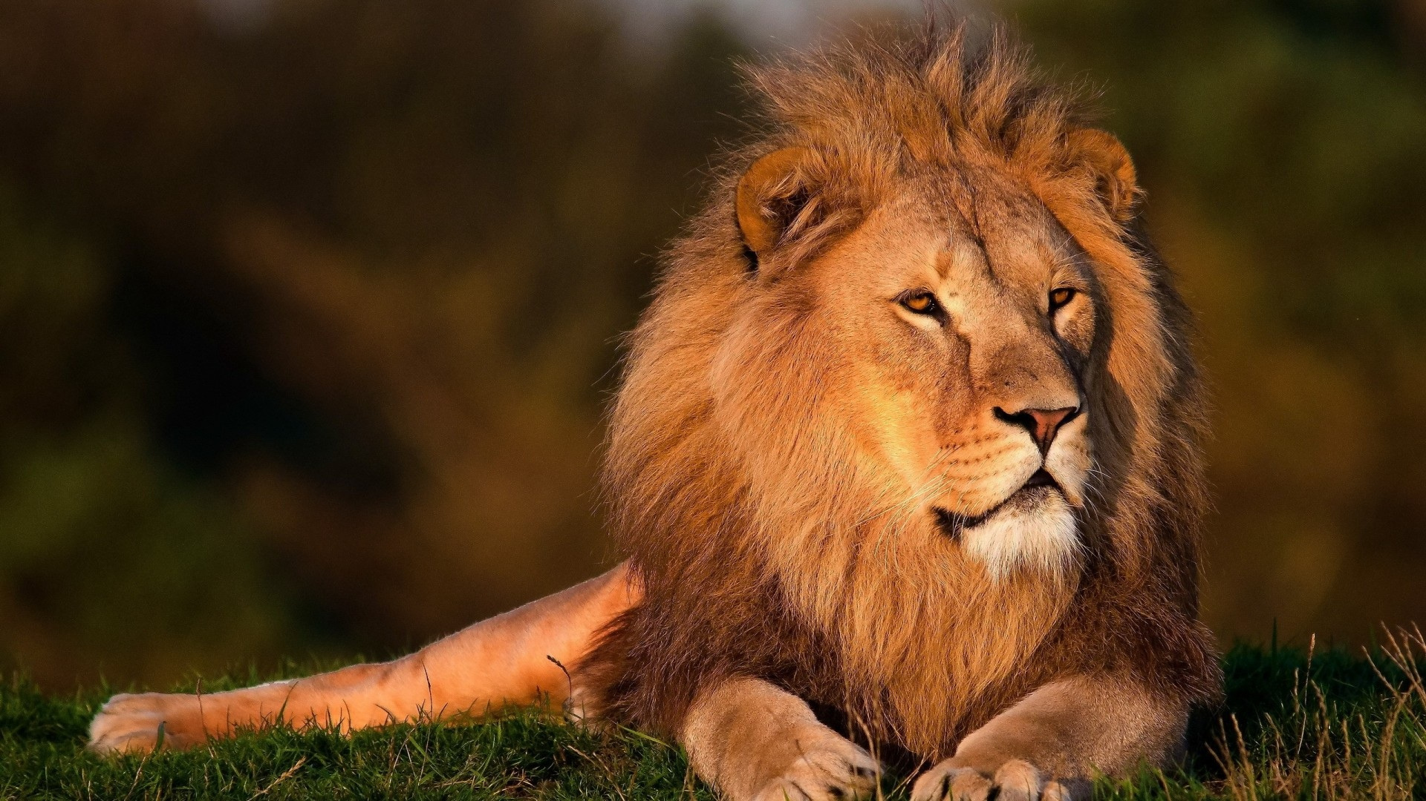
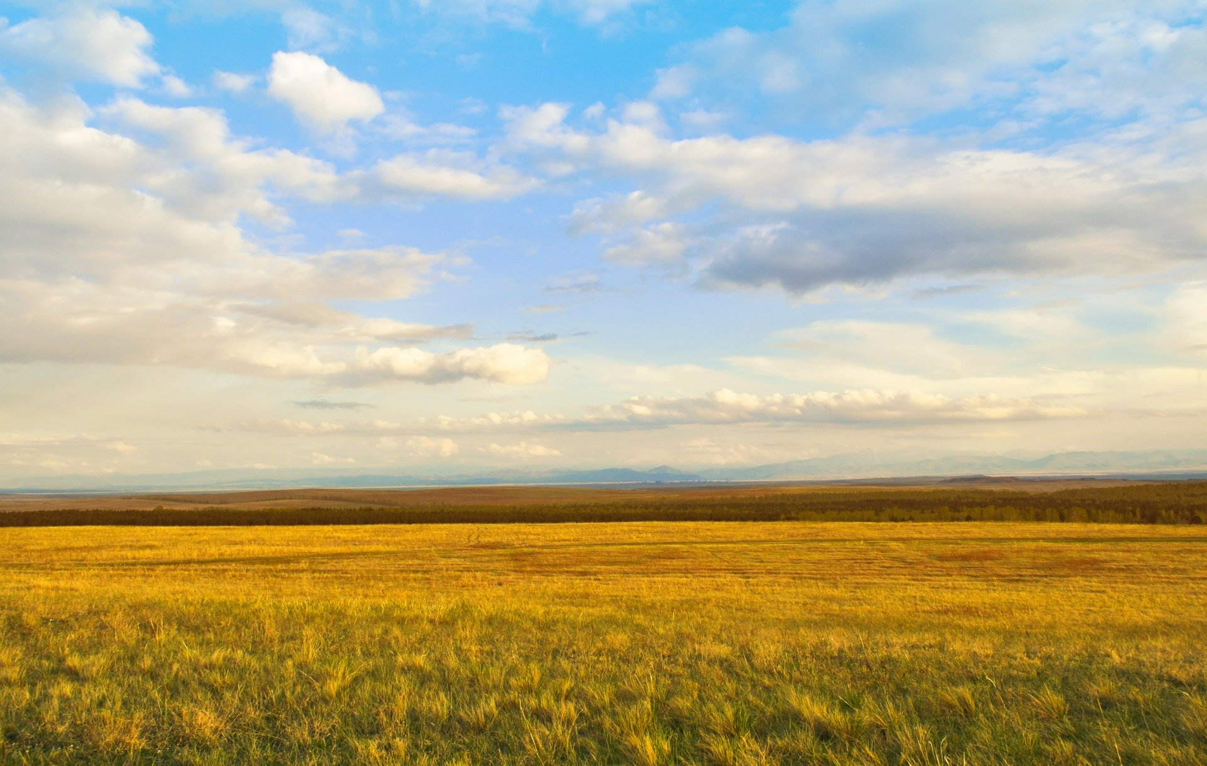
THE LION’S
ROAR
This week’s topic

Slide 2
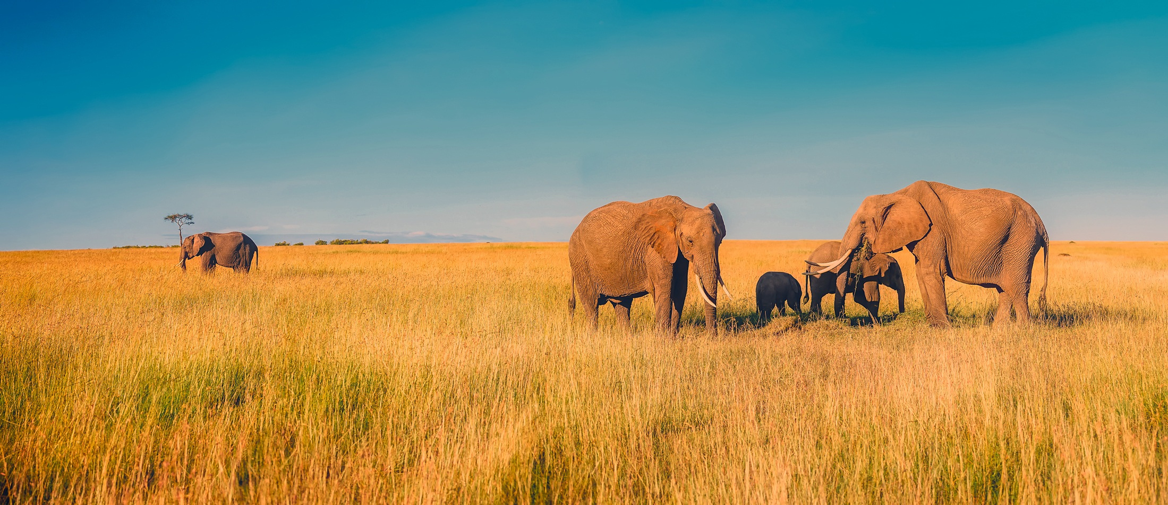
WARM UP
How do you think different animals use sounds to communicate with each other?

Slide 3
PREVIEWING
Read the information. The words and phrases in bold appear in the video. Match each word with its definition.
The lion is known for its power and strength, as well as its famously fierce roar. In fact, a lion’s roar can be as loud as 114 decibels—about as loud as thunder. These sounds are made by both lions and lionesses, though lionesses do not roar as often, or as loudly.
Male lions—especially the dominant lion in the pride (the lion family group)—roar to warn others to leave their territory. They also roar to communicate their location to their family; this is called social roaring.
1. thunder • • a. the loud sound you hear after lightning
2. dominant • • b. an area of land belonging to a particular person or group
3. territory • • c. more important or powerful than most or all others

Slide 4
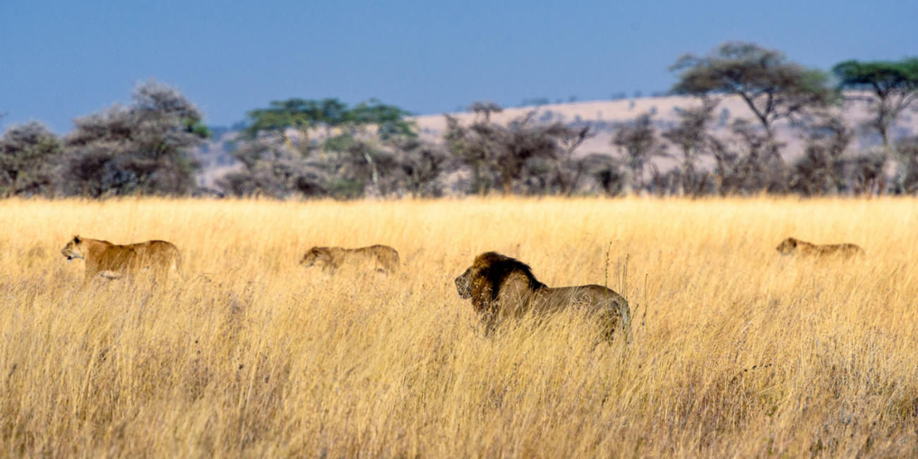
WHAT DO YOU KNOW ABOUT LIONS? DISCUSS THE QUESTIONS BELOW WITH A PARTNER.
1. Which is bigger, a lion or a tiger?
2. What is the name given to a group of lions?
3. Which usually hunts for food—the male or the female lion?
4. In which two continents do lions live today?

Slide 5
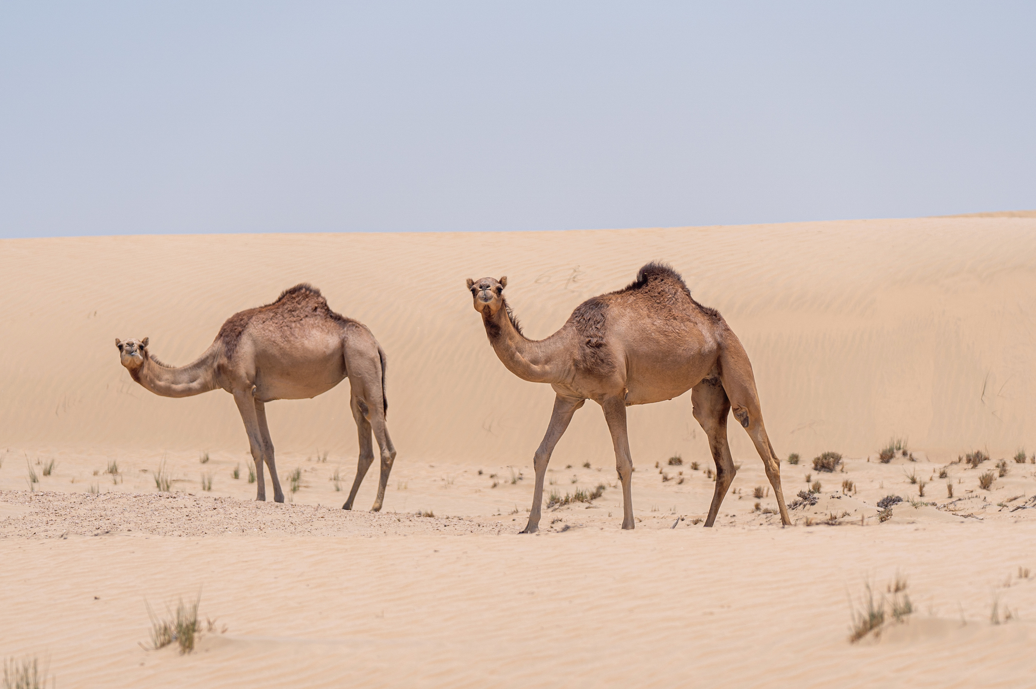

WATCH THE VIDEO. CHECK YOUR IDEAS IN PREVIEWING.
1. Which is bigger, a lion or a tiger?
2. What is the name given to a group of lions?
3. Which usually hunts for food—the male or the female lion?
4. In which two continents do lions live today?
Notes:
https://www.youtube.com/watch?v=0oqxdt02m7E

Slide 6
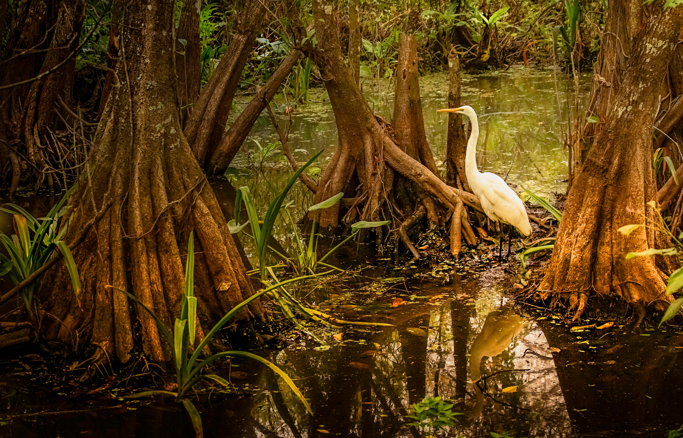
WATCH THE VIDEO AGAIN. COMPLETE THE SENTENCES BY CIRCLING THE CORRECT OPTIONS.
1. Lions are able to roar as soon as they are born / when they are one year old.
2. There are usually more adult males / females in a pride of lions.
3. American lions and cave lions became extinct around 1,000 / 10,000 years ago.
  4. African / Asiatic lions are the most endangered lion species today.
Notes:
https://www.youtube.com/watch?v=0oqxdt02m7E

Slide 7
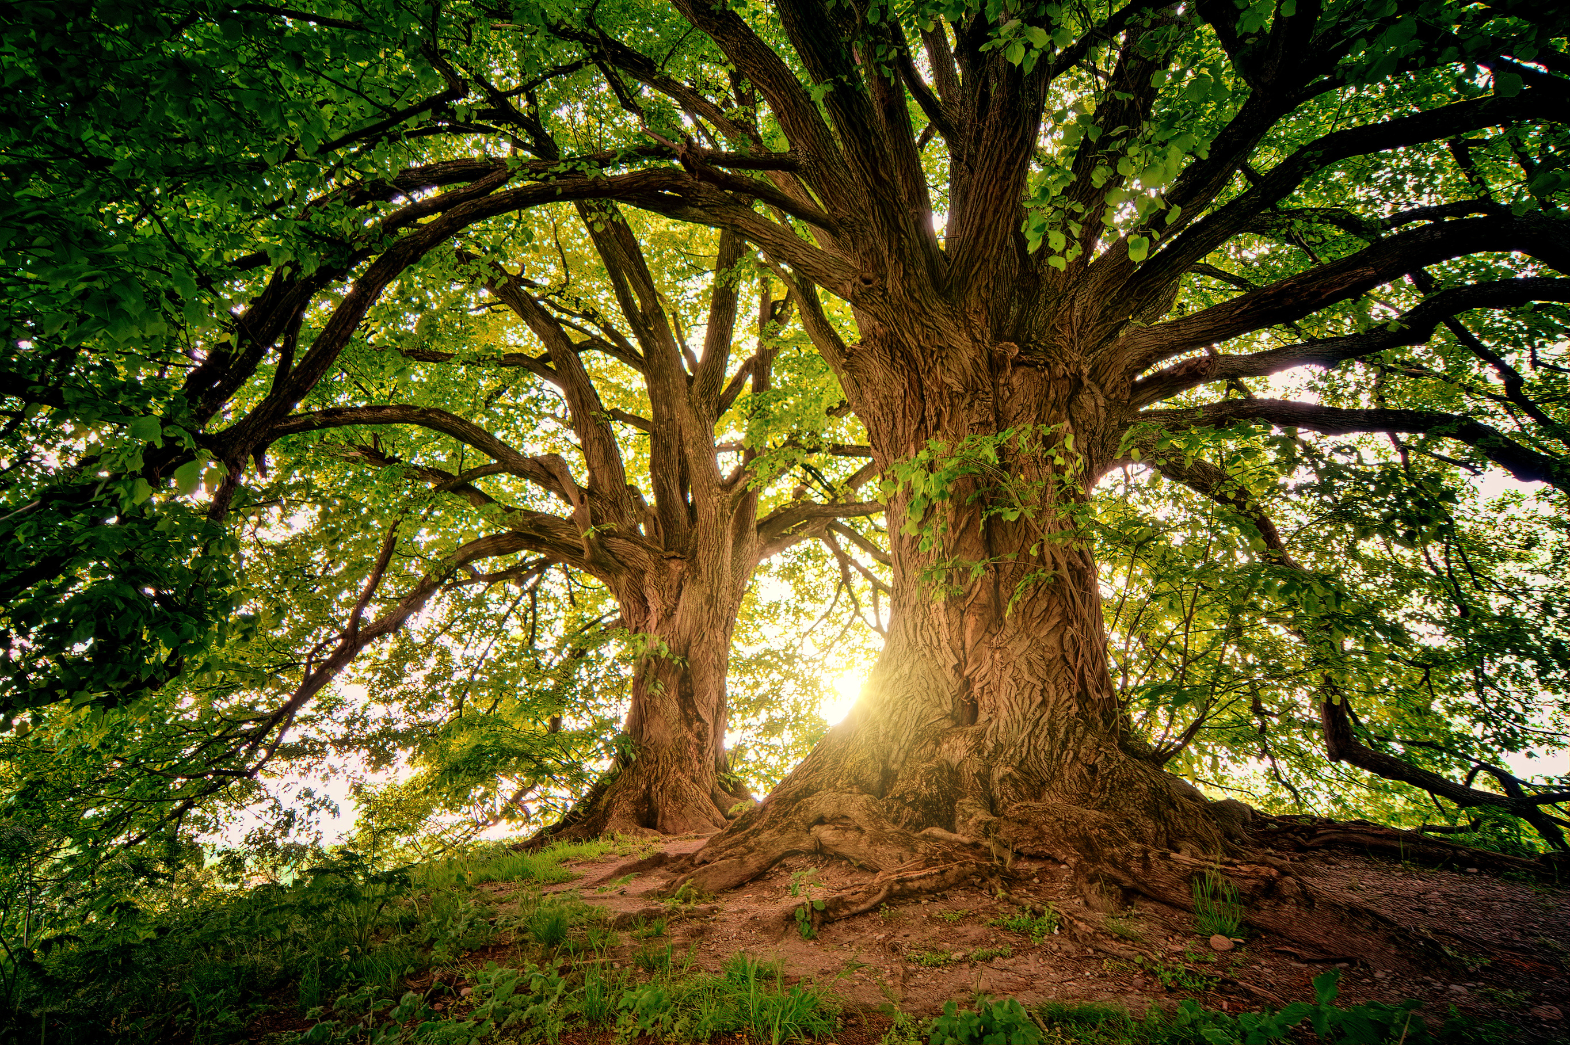
Discussion

Slide 8
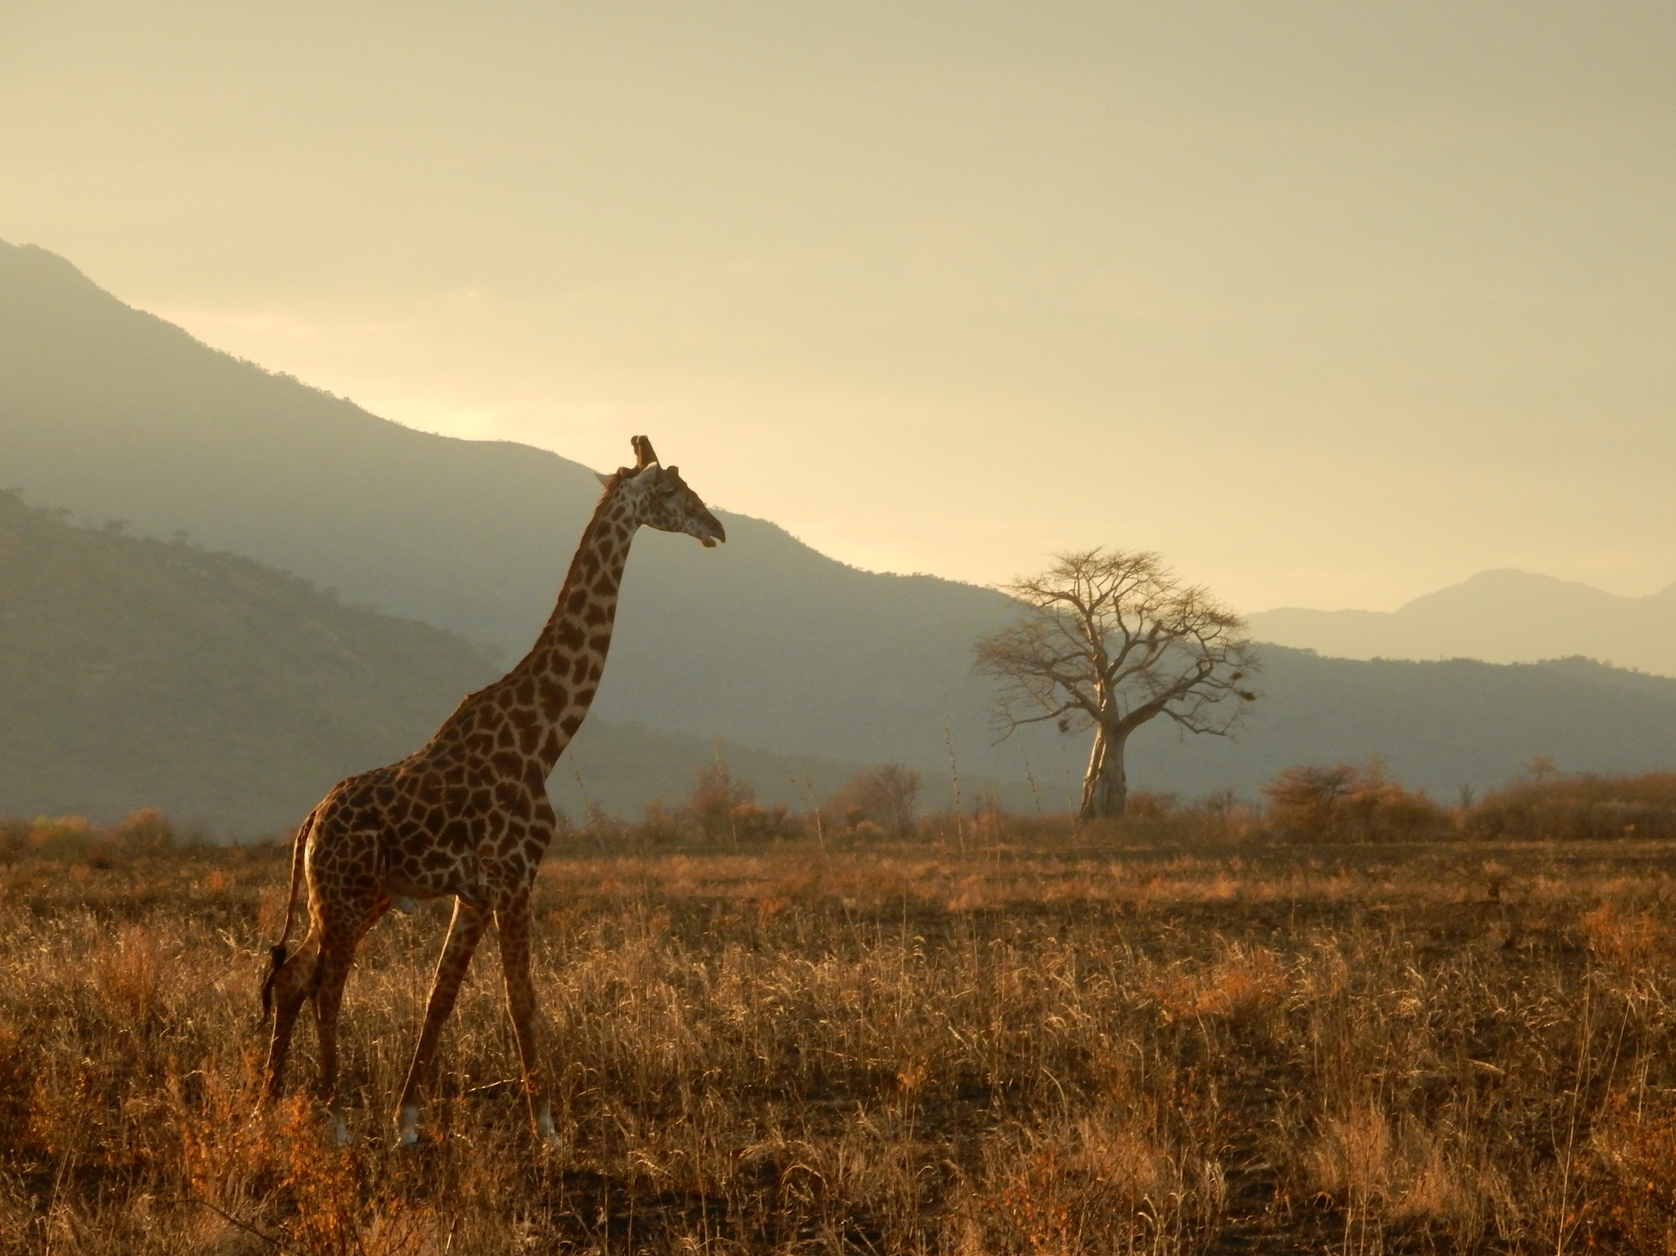
  In what ways do you think animal calls, like roaring or chirping, are important for their survival?

Slide 9
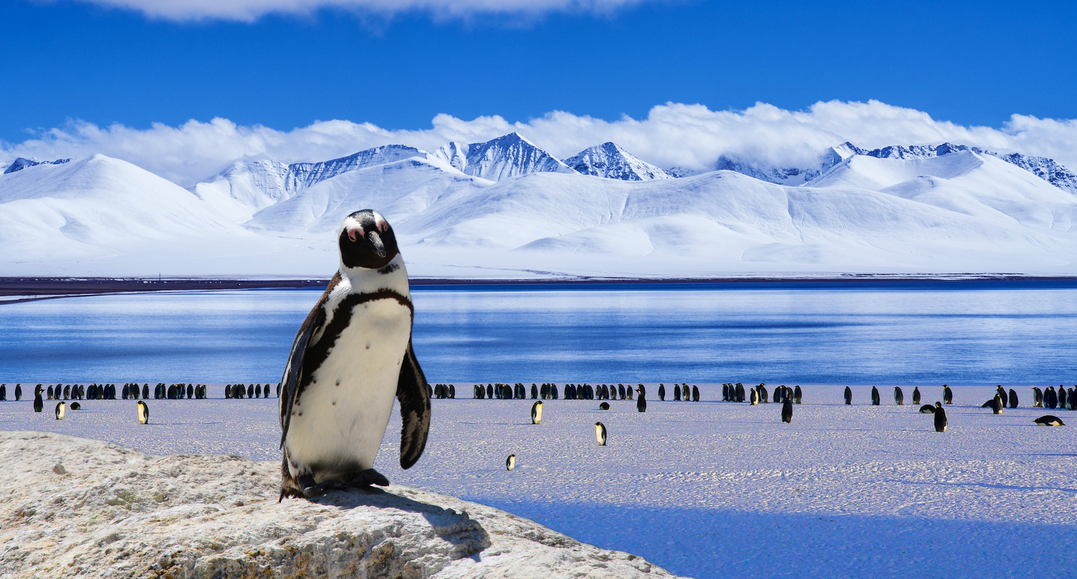
Do you think all animals communicate in the same way? Why or why not?

Slide 10
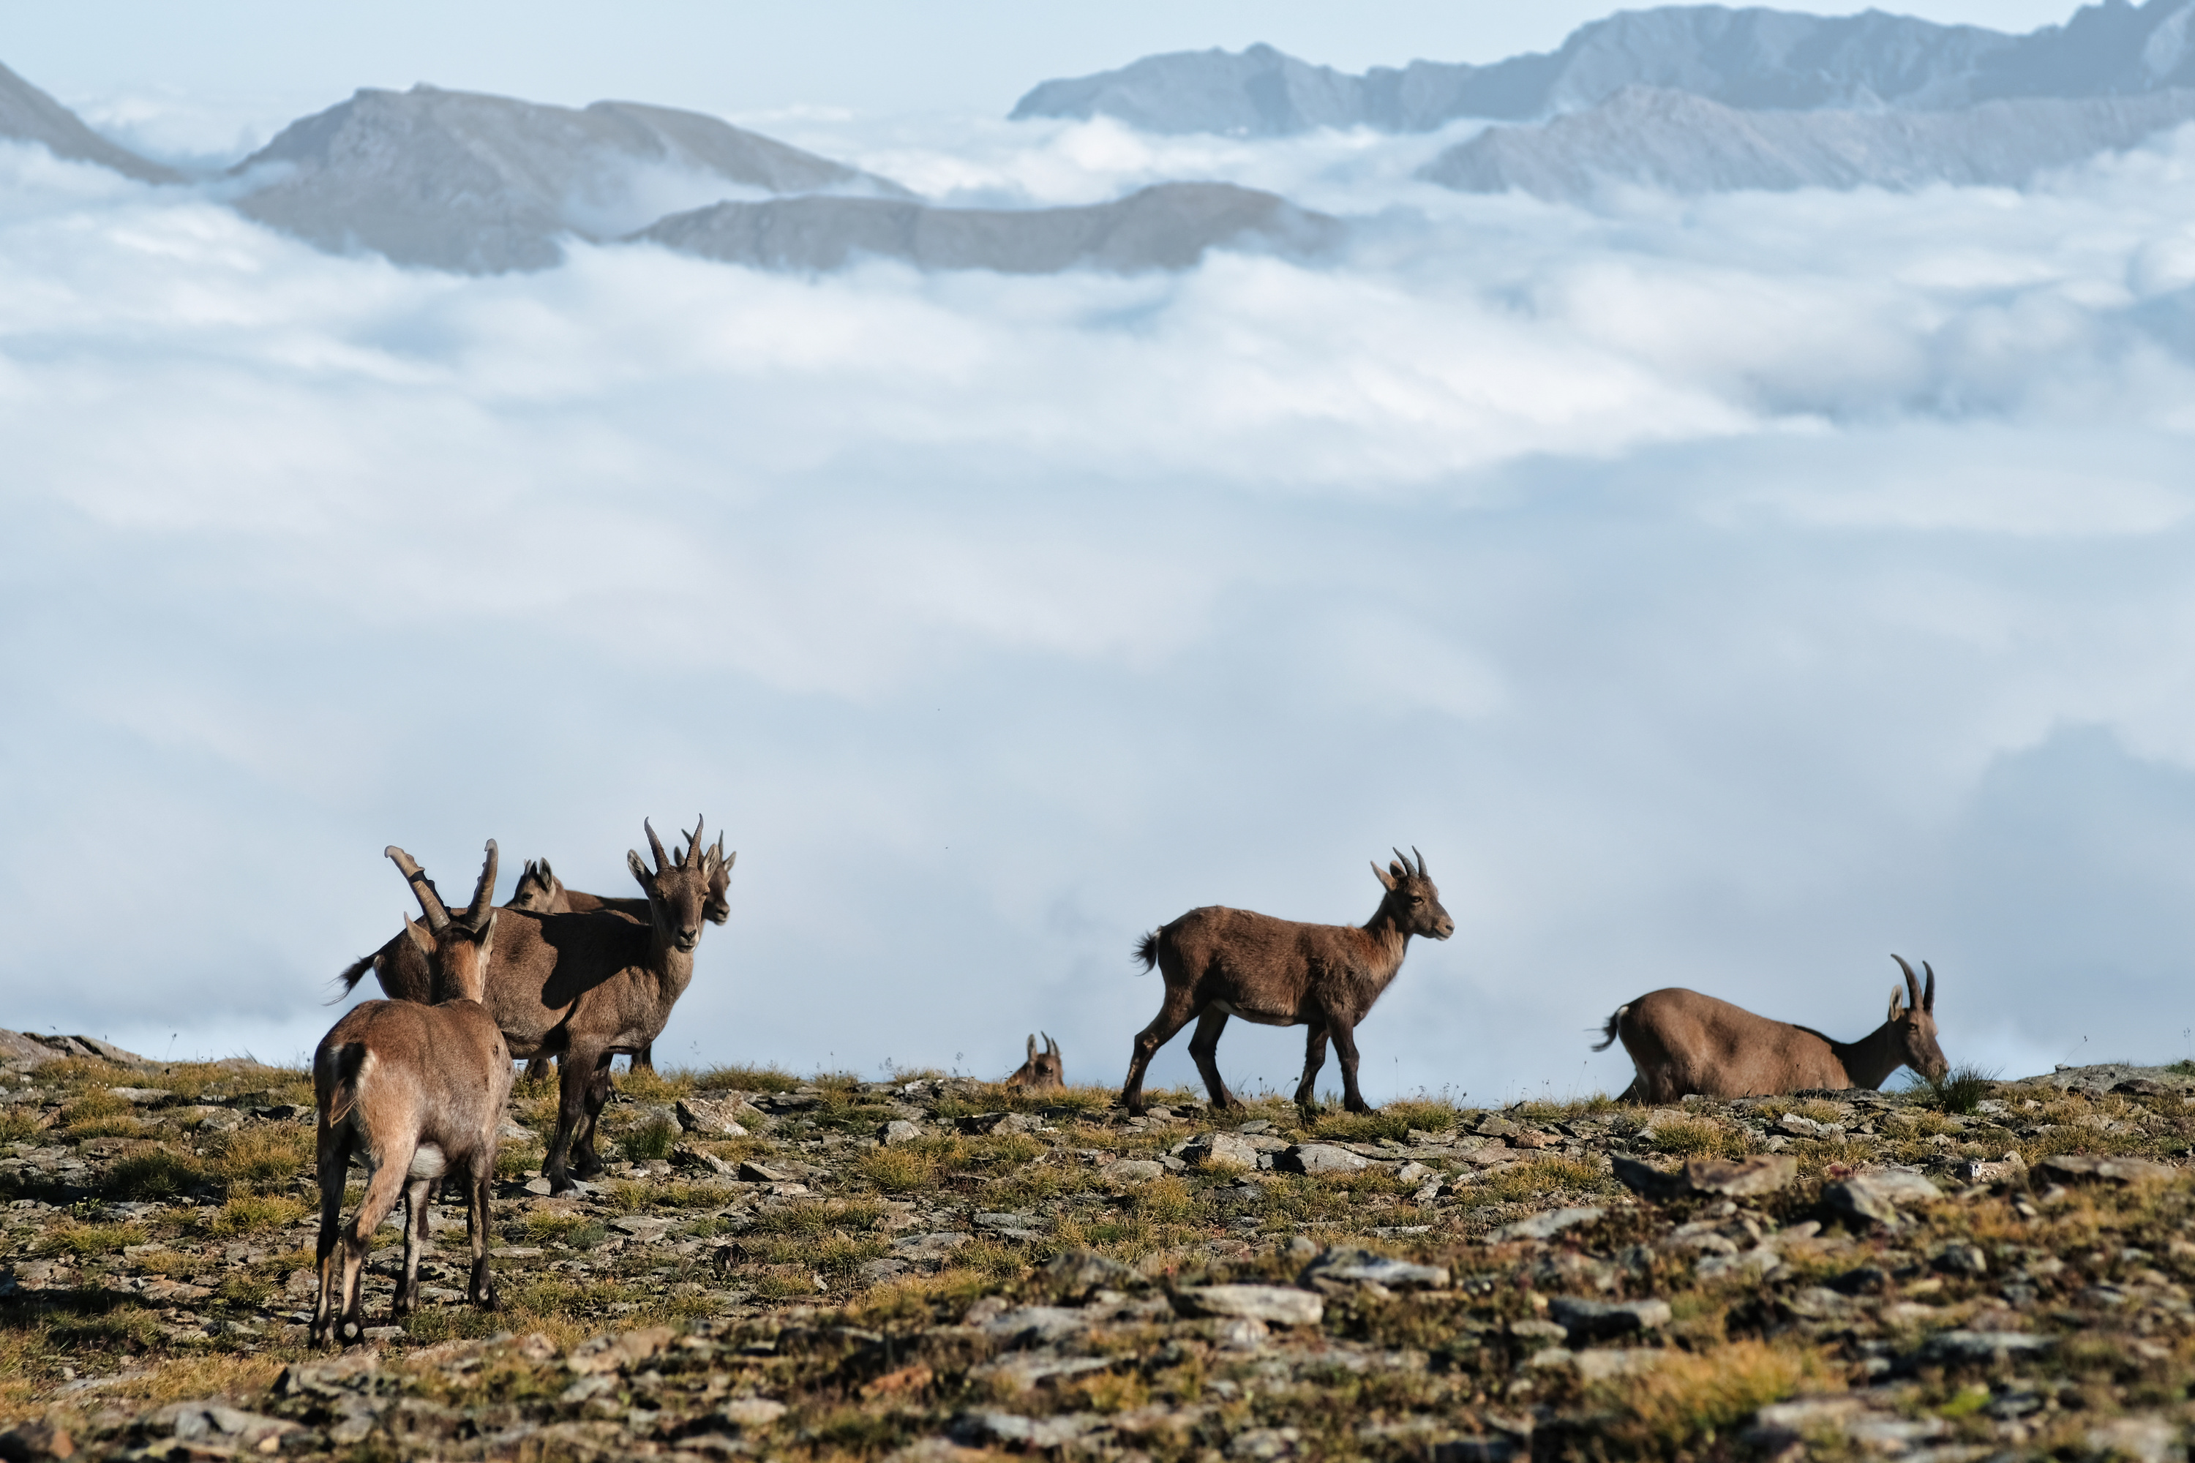
  Why do you think some animals make sounds only in certain situations (like danger or mating season)?

Slide 11
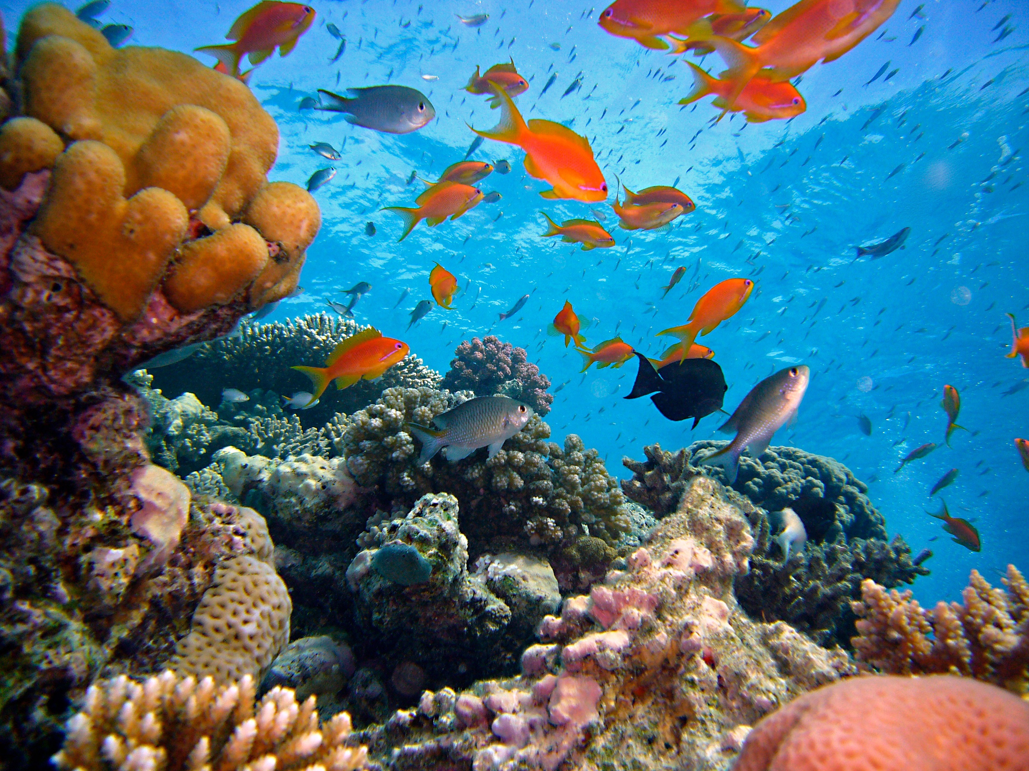
Why do you think lions are the only cats that live in prides while other big cats like tigers are solitary?

Slide 12
How do you think animals choose their sounds? Are some calls learned, or do they develop them instinctively?

Slide 13
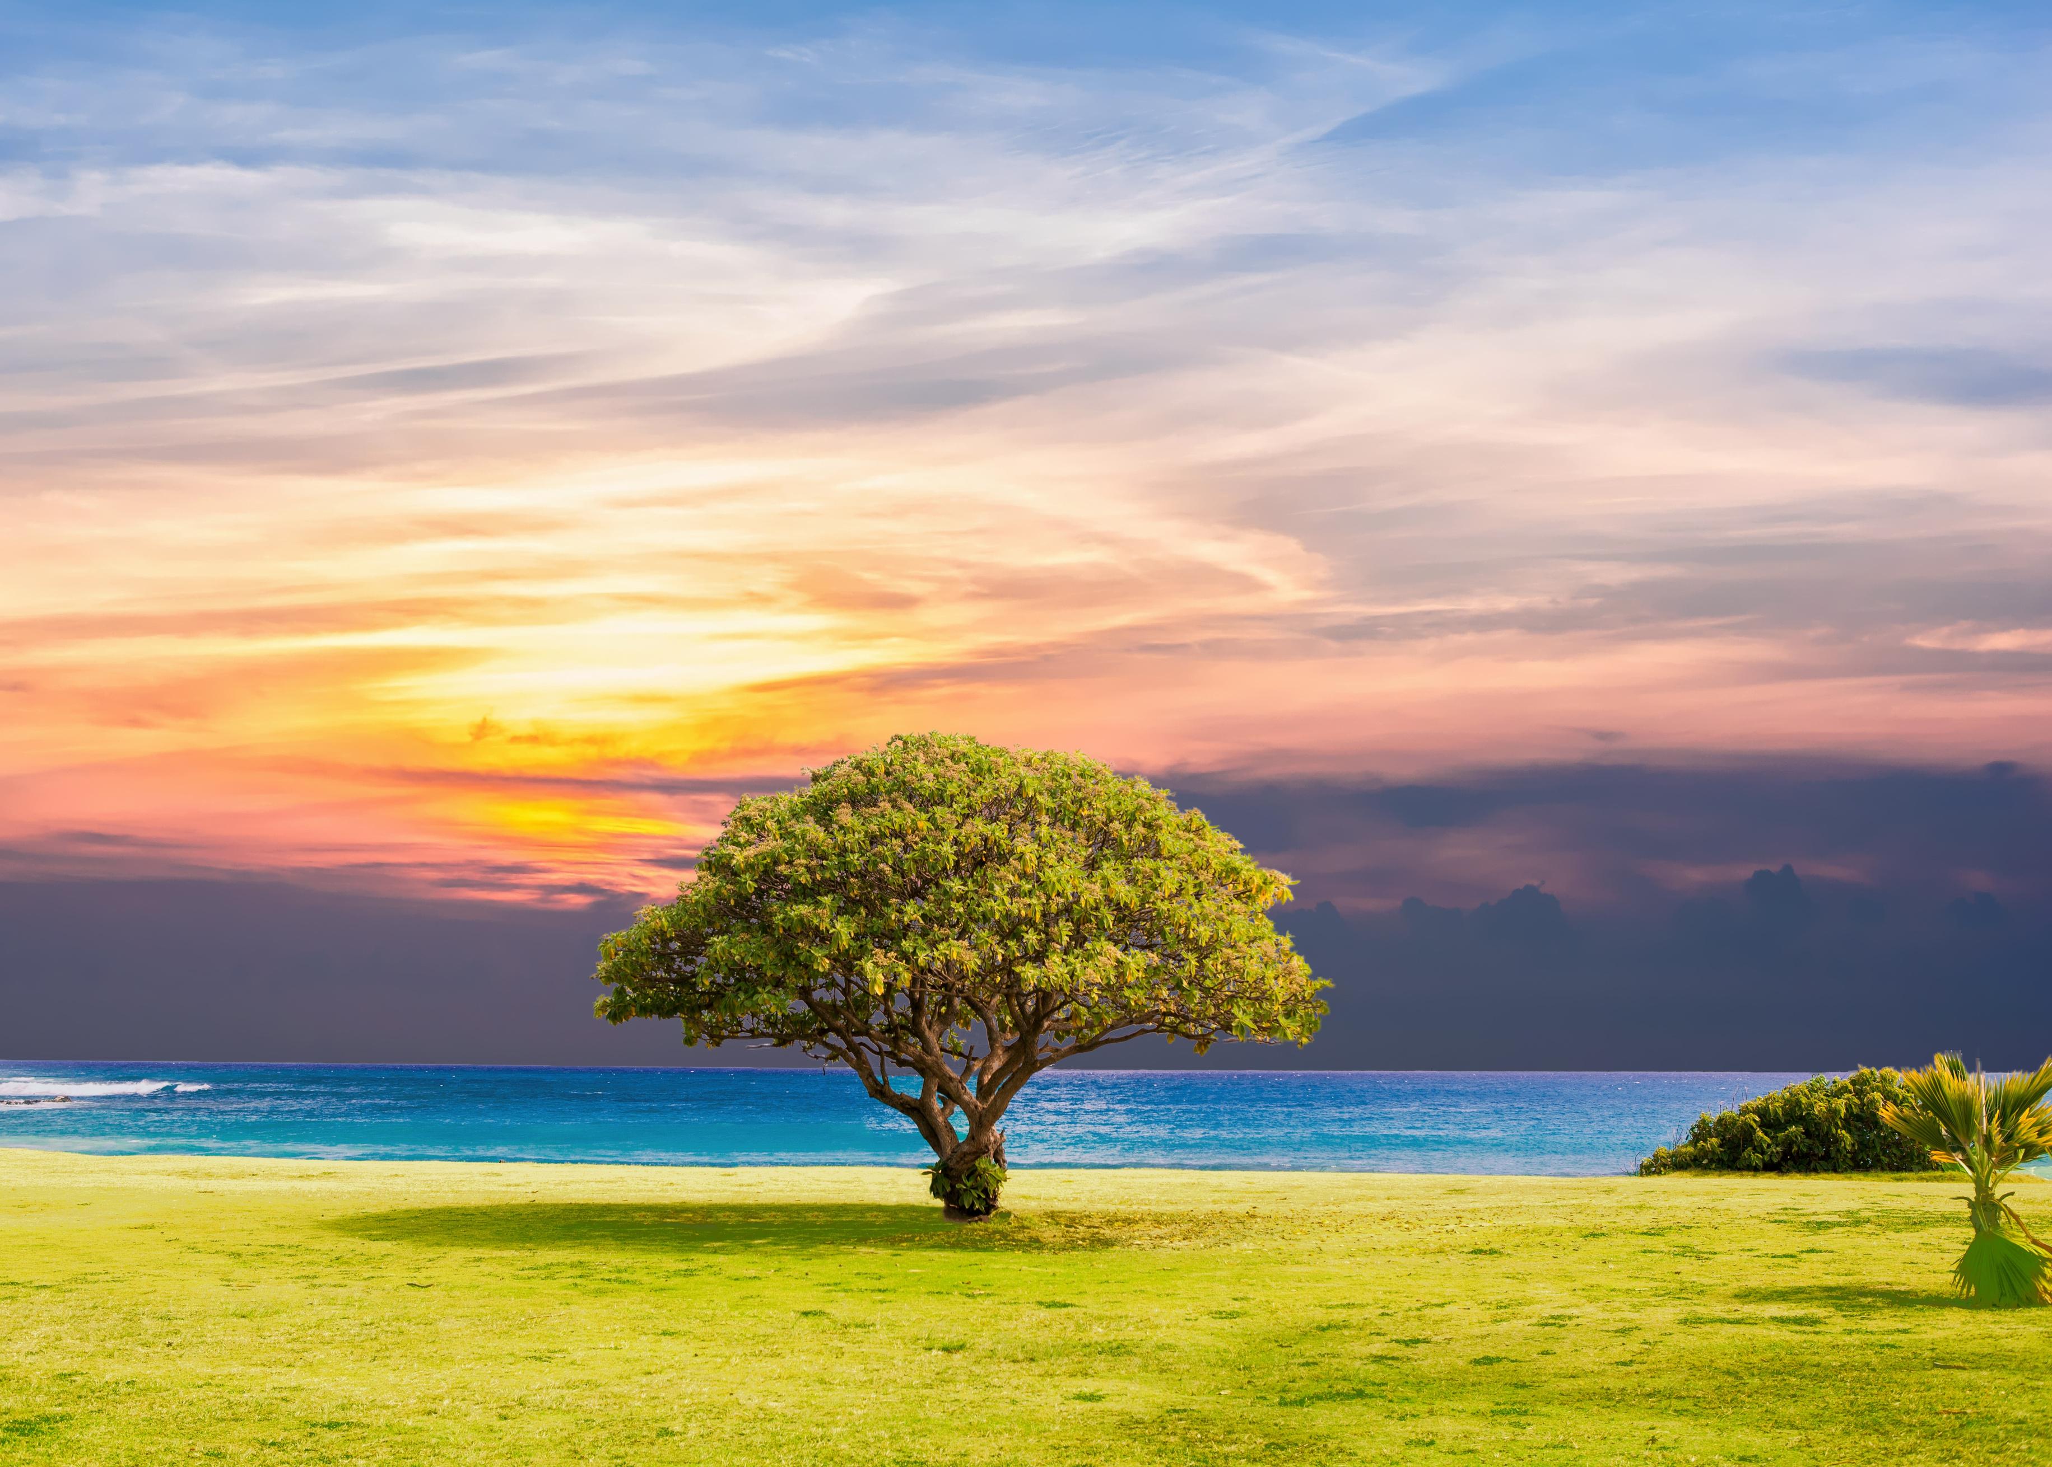

THANK
YOU!

